Slide 1

Operator Overloading
Lecture 08

Slide 2
Operator overloading
Operator overloading is one of the advanced concepts of C++.
It is a feature through which most of the standard operators can be used with class objects.
Two types of operators can be overloaded:
Unary Operator
Binary Operator

Slide 3
Why Operator overloading is used in C++ programming?
You can write any C++ program without the knowledge of operator overloading. But, operator operating are profoundly used by programmer to make a program clearer.
For example: you can replace the code like:
calculation = add(mult(a,b),div(a,b)); with calculation = a*b+a/b; which is more readable and easy to understand.

Slide 4
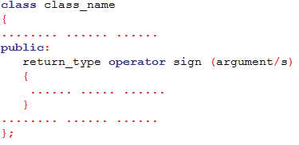
How to overload operators in C++ programming?
To overload a operator, a operator function is defined inside a class

Slide 5
Things to remember while using Operator overloading in C++ language
Operator overloading cannot be used to change the way operator works on built-in types. Operator overloading only allows to redefine the meaning of operator for user-defined types.
Not all operators in C++ language can be overloaded. The operators that cannot be overloaded in C++ are ::(scope resolution), .(member selection), .*(member selection through pointer to function) and ?:(ternary operator).
There are two operators assignment operator(=) and address operator(&) which does not need to be overloaded. Because these two operators are already overloaded in C++ library.
For example: If obj1 and obj2 are two objects of same class then, you can use code obj1=obj2; without overloading = operator. This code will copy the contents object of obj2 to obj1.
Similarly, you can use address operator directly without overloading which will return the address of object in memory.

Slide 6

Example
#include <iostream>
using namespace std;
class temp
{
private:
int count;
public:
temp():count(50){ }
void operator ++()
{
count=count+10;
}
void Display()
{
cout<<"Count: "<<count;
}
};
int main()
{
temp t;
++t; /* operator function void operator ++() is called */
t.Display();
return 0;
}

Slide 7
Example of Overloaded - operator
#include <iostream>
using namespace std;
class Complex{
private:
float real;
float imag;
public:
Complex(): real(0), imag(0){ }
void input()
{
cout<<"Enter real and imaginary parts respectively: ";
cin>>real;
cin>>imag;
}
Complex operator - (Complex c) /* Operator Function */
{
Complex temp;
temp.real=real-c.real;
temp.imag=imag-c.imag;
return temp;
}

Slide 8
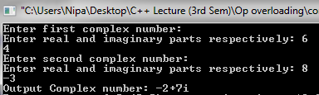
Example of Overloaded - operator
void output()
{
if(imag<0)
cout<<"Output Complex number: "<<real<<imag<<"i";
else
cout<<"Output Complex number: "<<real<<"+"<<imag<<"i";
}};
int main()
{
Complex c1, c2, result;
cout<<"Enter first complex number:\n";
c1.input();
cout<<"Enter second complex number:\n";
c2.input();
result=c1-c2;
result.output();
return 0;
}

Slide 9
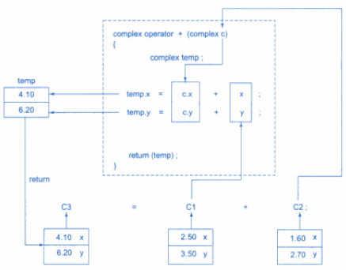
Implementation of Overloaded + operator

